Slide 1
Lecture Test 1 Packet B

Slide 2
In the 1600’s, Robert Hooke used a compound light microscope when looking at dead cork tissue and was the first to use the term “cell” to describe the basic unit of all living things.

Slide 3
In the 1670’s, Anton van Leeuvanhoek was the first to see, draw and describe “wee beasties” and “small animacules” which were bacteria and protozoa; we consider him the “father of bacteriology and protozoology.

Slide 4
THE GOLDEN AGE OF MICROBIOLOGY (1857 – 1914) With the development of the microscope, the age old controversies of spontaneous generation, fermentation and the germ theory of disease were finally solved.

Slide 5
LOUIS PASTEUR (France) – the “father of microbiology”

Slide 6
Pasteur disproved the theory of spontaneous generation, as it related to microbes, with his swan neck flask experiments.

Slide 7
Pasteur also discovered how fermentation occurred and that yeast cause the fermentation of grape juice into wine. To save the French wine industry, which was suffering from a problem where many wine bottles started to contain vinegar, instead of wine, Louis Pasteur developed the process of PASTEURIZATION. Pasteur also determined why vaccines worked and went to work developing vaccines. One vaccine he developed for rabies, led to him being paid a large sum of money, with which he established the Pasteur Institute. Pasteur was also interested in trying to prove the “germ theory of disease.”

Slide 8
With the discovery of bacteria and proof that biogenesis occurs to create all living organisms, the next major step in microbiology was to prove the GERM THEORY OF DISEASE. The germ theory of disease tried to prove that microbes could cause people to get sick.

Slide 9
Robert Koch (Germany) – the “father of the microbiology laboratory”

Slide 10
Koch’s Postulates- a method of determining the etiologic agent of infectious diseases. 1. The suspected etiologic agent must be found in every case of the disease and be absent in healthy hosts. 2. The suspected etiologic agent must be isolated in pure culture and identified. 3. The suspected etiologic agent when inoculated into a healthy susceptible host must come down with the same disease as in step 1. 4. The same etiologic agent from step 2 must be isolated and identified in the second diseased animal. Koch proved that bacteria do cause infection and disease AND with his postulates developed a method to identify which bacteria cause each infectious disease.

Slide 12
Koch and his colleagues also contributed other advances in the microbiology laboratory including: a) simple staining techniques were developed to see bacteria b) the first photographs of bacteria in diseased tissue were taken c) the use of steam was first used to sterilize media d) the use of agar was first used to solidify bacterial growth media e) aseptic transfer of bacteria using platinum wires was first proposed f) the use of the Petri dish was started

Slide 13
In 1884, Christian Gram (Denmark) developed the Gram stain.

Slide 14
In 1892, Dmitri Ivanovski (Russia) discovered the Tobacco Mosaic virus.

Slide 15
With the proof of the Germ Theory of Disease, the next step in microbiology was to understand how this information could be used to prevent disease in clinical settings.

Slide 16
Edward Jenner (England) – in the late 1700’s he developed the first vaccine known in the western world; the vaccine he developed protected people from smallpox.

Slide 17
Ignaz Semmelweis (Austria) – in the mid 1800’s he was perplexed over the high numbers of cases or puerperal fever in mothers of newborn babies; he hypothesized that perhaps the doctors delivering the babies should WASH THEIR HANDS!!

Slide 18
Joseph Lister (England) – in the mid 1800’s he was the founder of antiseptic surgery and the use of antiseptics in health care.

Slide 19
Florence Nightingale (England) in the mid 1800’s she introduced cleanliness and other antiseptic techniques to nursing practice and started nursing education.

Slide 20
John Snow (England) – in the mid 1800’s he mapped the cases of cholera in London and started the studies of infection control and epidemiology.

Slide 21
Also knowing that microbes cause diseases, microbiologists and physicians began to work to develop chemotherapeutic agents to selectively destroy bacteria to treat humans with infectious diseases. Selective toxicity – the ability to kill infectious organisms without killing the infected human.

Slide 22
Paul Ehrlich (Germany) – in the early 1900’s he began the study of chemotherapy and developed the first lab synthesized drug, used to treat a disease, that was selectively toxic.

Slide 23
Alexander Fleming (England) – in 1929, he discovered penicillin, the first true antibiotic.

Slide 24
Today, microbiology is in the modern era and has largely untapped room for exploration in the fields of epidemiology, genetic engineering, immunology, vaccines, bioremediation and in industry. We also must be aware of the dangers associated with some of these advancements as well as the possibilities of using microbes as tools of bioterrorism.

Slide 25
EPIDEMIOLOGY - the study of the effects of disease on populations, the transmission, incidence and frequency of disease.

Slide 26
The CDC (Centers for Disease Control and Prevention- headquartered in Atlanta) is the main source of epidemiologic information in the U.S. The CDC publishes the MMWR (Morbidity and Mortality Weekly Report), which provides information on the morbidity (sickness) and mortality (death) due to reportable (notifiable) diseases.

Slide 27
With reportable diseases there is a phenomenon called the ICEBERG EFFECT: - the number of cases of reportable illness in the MMWR is assumed to underestimate the real number of people in population with each disease.

Slide 28
Disease outbreaks can be classified by their frequency of occurance: Sporadic = a few isolated cases widespread in a population that occur in an unpredictable manner Endemic = a constant number of cases seen over a long period of time in a specific region Epidemic = a drastic increase in the number of cases, beyond what is expected for a population Pandemic = an epidemic that occurs across continents

Slide 29
Reportable diseases:
-Notifiable diseases
-By law, some diseases must be reported to authorities
-Other diseases are reported on a voluntary basis

Slide 30
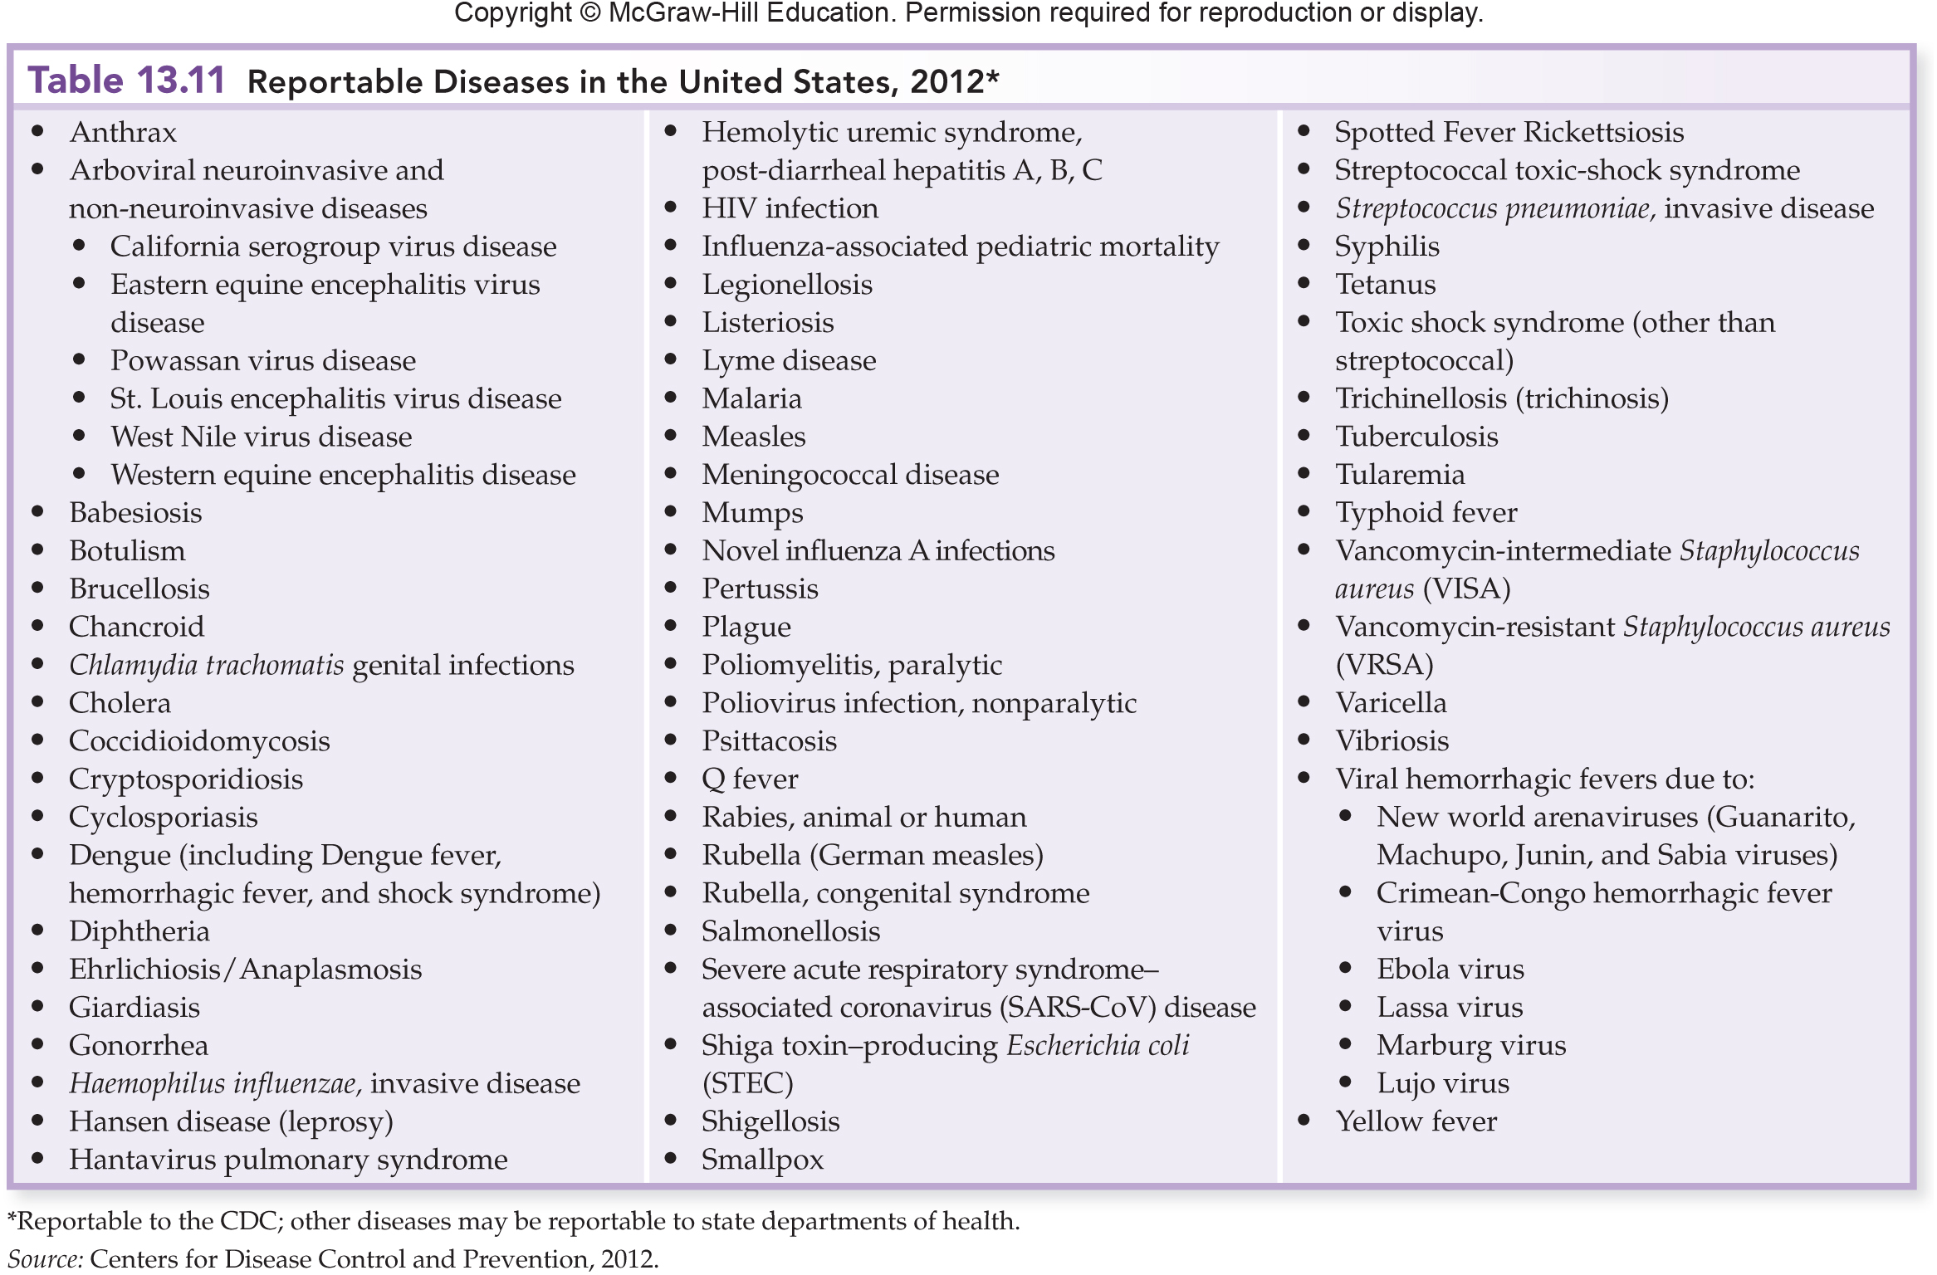

Slide 31
Some epidemiologic terms commonly used in medicine: Symptoms vs. signs of disease, are they different things? Symptoms are the subjective feelings of the patient and include: Chills, Headache, Malaise Signs are the objective findings of medical personnel and include: Fever, Swollen Lymph Nodes (Syndromes are diseases that are always accompanied by a specific group of signs and symptoms)

Slide 32
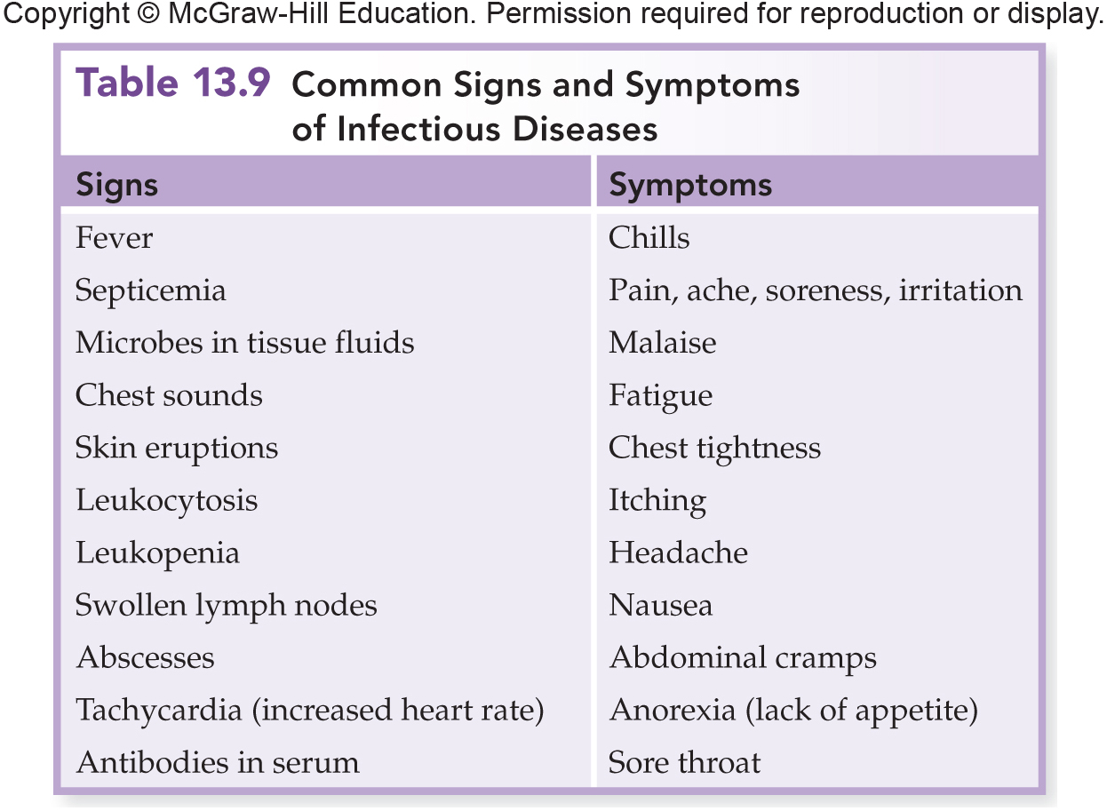

Slide 33
There are certain recognized phases of infectious disease: Incubation period = the period when an infection first occurs when no signs or symptoms are yet apparent Prodromal period = the period during an infection when the patient first begins to notice signs and symptoms Disease period = the period when the infection causes illness (disease) Decline period = when the signs and symptoms begin to go away Convalescence period = the period during an infection when signs and symptoms resolve and the patient recuperates

Slide 34
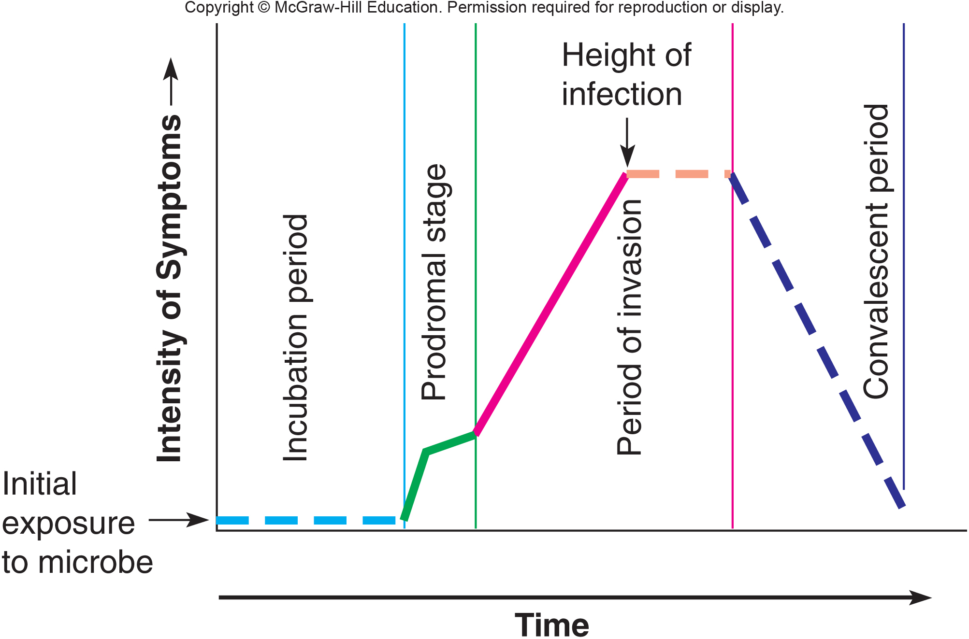
What Happens in Your Body

Slide 35
Stages of disease – identify the stages of infection in a person suffering from a cold sore.

Slide 36
Communicable diseases are those diseases that are transmitted (passed) directly or indirectly from one person to another. - chicken pox* - herpes simplex I - measles* - typhoid fever - tuberculosis (TB) Contagious diseases* are communicable diseases that can be easily passed from one person directly to another. Non-communicable diseases are not easily transmitted from one person to another and normally grow outside the body.

Slide 37
Reservoirs of disease are long term animate or inanimate objects that serve as a habitat for an infectious agent. - a FOMITE is an inanimate (non-living) object that serves as a reservoir of disease; give some examples.

Slide 38
- a VECTOR is an animal that transmits disease. - zoonotic diseases are infections that animals get and which can be passed on to humans - vectors can be described as: MECHANICAL vectors, transport infectious agent BIOLOGICAL vectors, transports infectious agent and participates in its life cycle

Slide 39
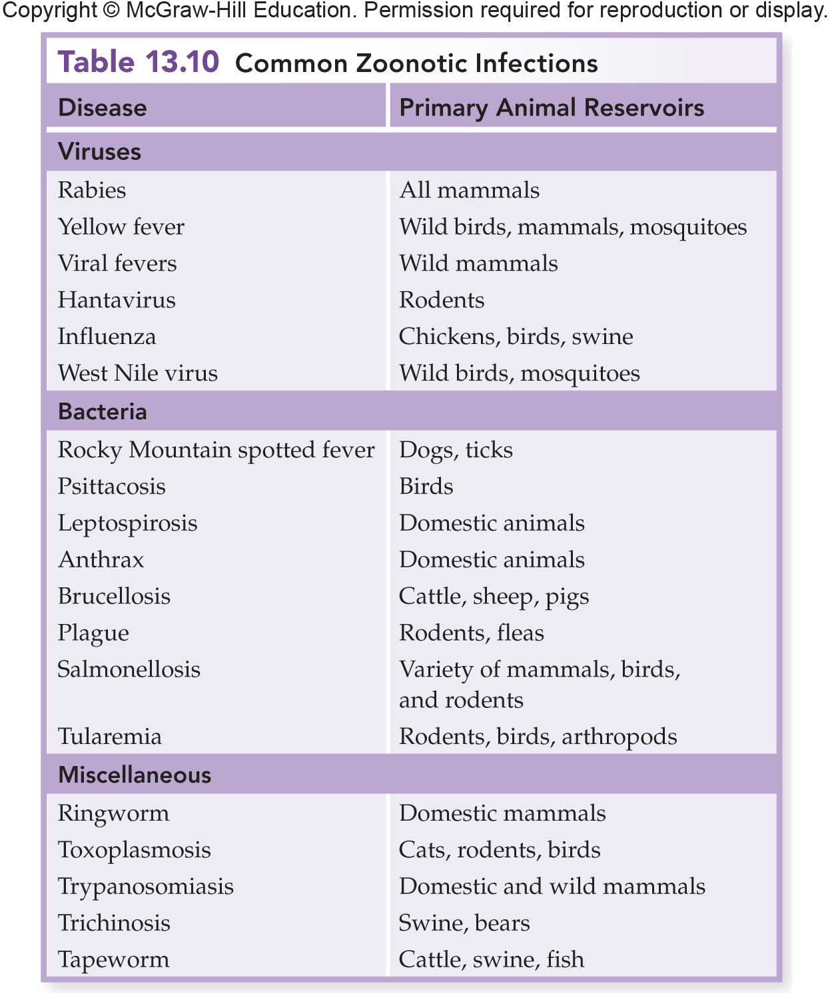
Animals as Reservoirs and Sources

Slide 40
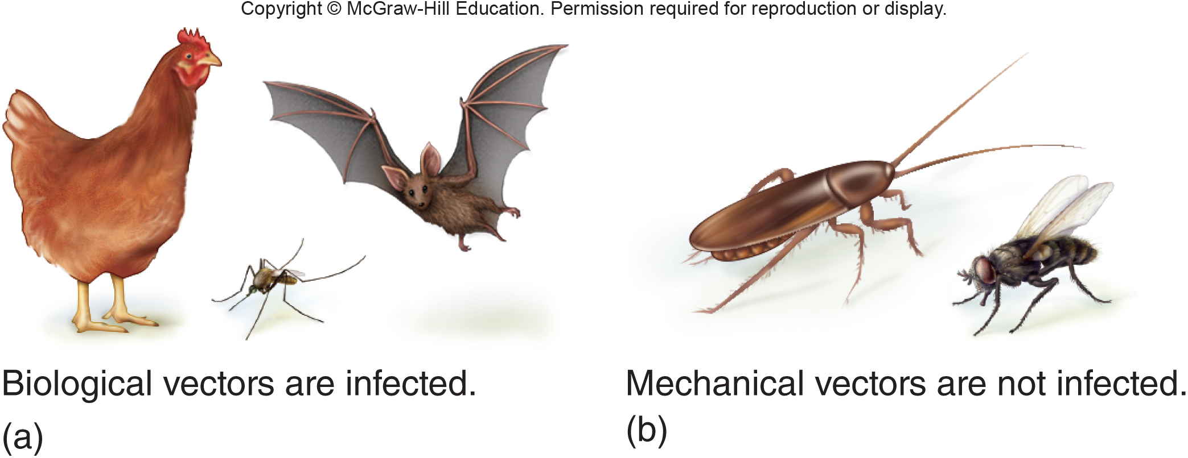
Actively participates in a pathogen’s life cycle
Serves as a site in which it can multiply or complete its life cycle
Not necessary to the life cycle of an infectious agent
Merely transport it without being infected

Slide 41
- a CARRIER is a person that transmits disease to another person - ACTIVE carriers have an overt clinical case of the disease - CONVALESCENT carriers have largely recovered but continue to harbor large numbers of the pathogen - ASYMPTOMATIC carriers (= healthy) carry the pathogen but aren’t ill - INCUBATION carriers incubate the pathogen in large numbers but are not yet ill - CHRONIC carriers harbor the pathogen for months, years or a lifetime after recovering from the illness

Slide 42
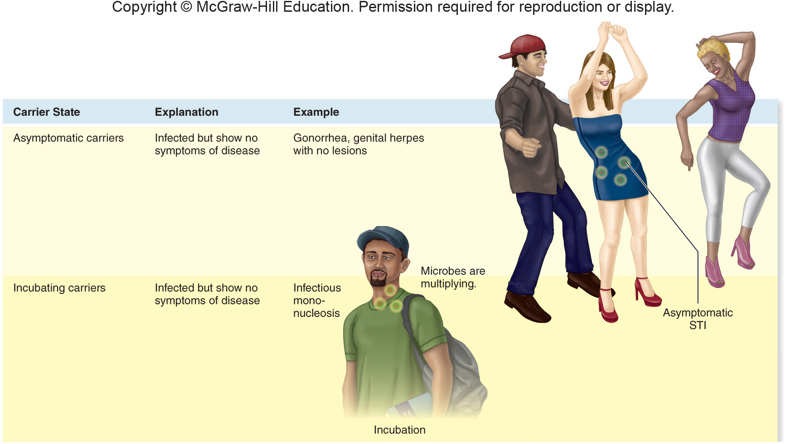

Slide 43
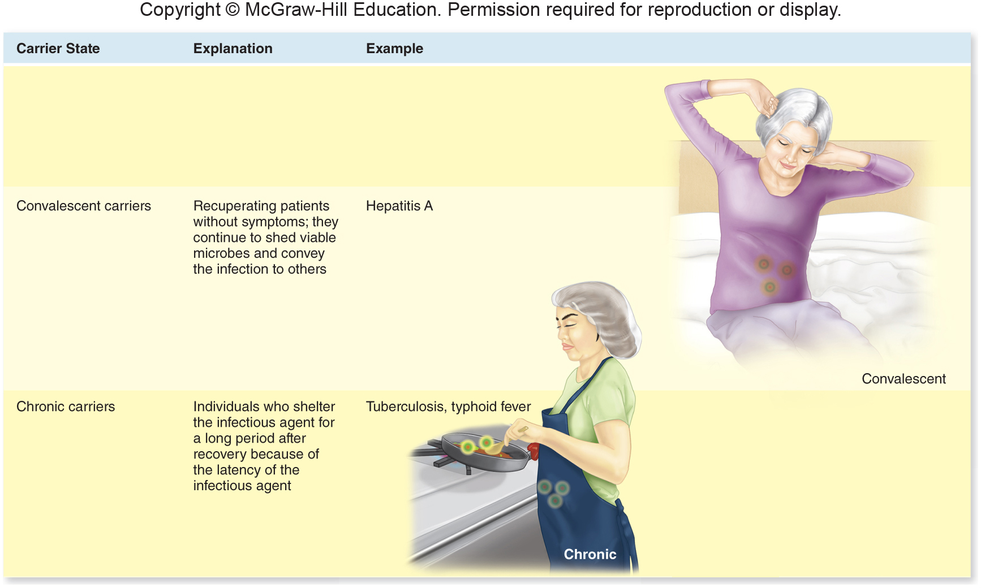

Slide 44
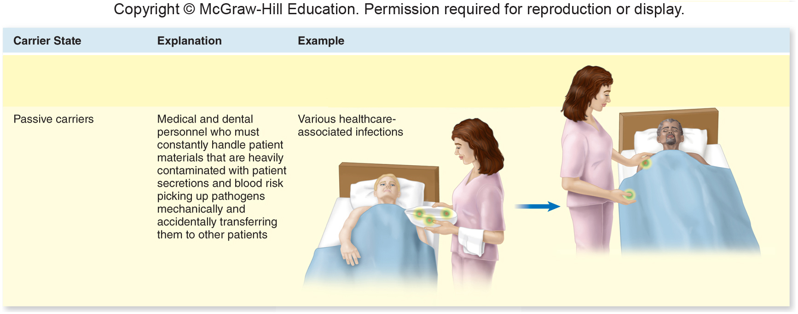

Slide 45
INFECTIOUS DISEASE TRANSMISSION usually occurs in one of the following ways: CONTACT - direct: touching, kissing, sexual intercourse - indirect: fomites - respiratory droplets that travel less than one meter from the reservoir to the host VEHICLES - airborne droplets that travel more than one meter from the reservoir to the host - waterborne - food-borne (food poisoning) VECTORS - mechanical - biological

Slide 46
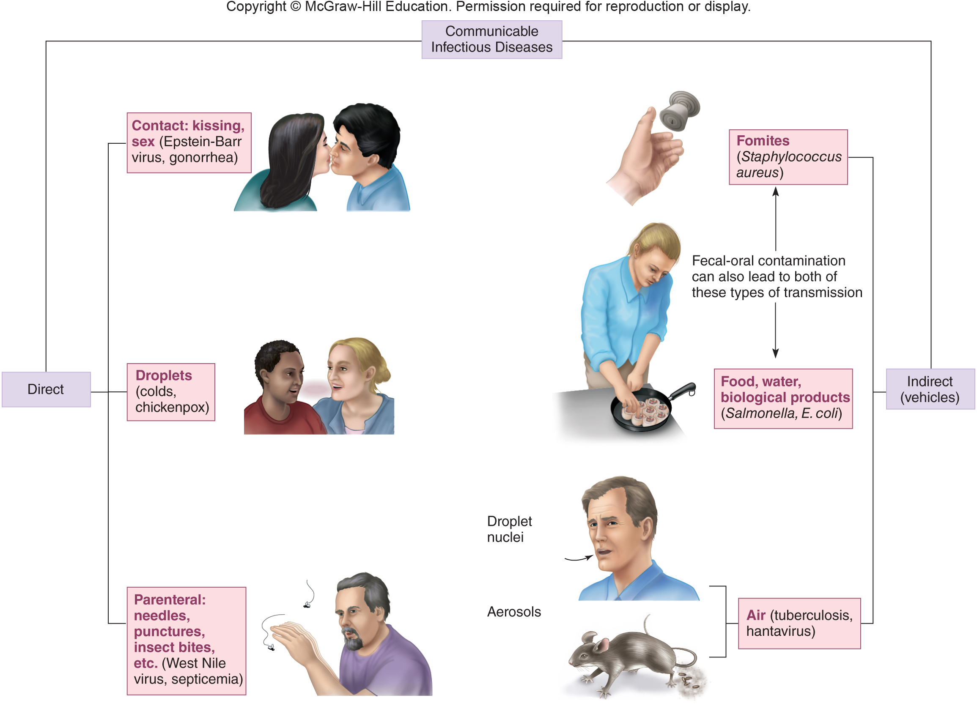
Patterns of Transmission in Communicable Diseases

Slide 47
CATEGORIES OF INFECTIONS

Slide 48
1. LOCAL INFECTIONS 2. FOCAL INFECTIONS 3. METASTATIC INFECTIONS 4. PRIMARY INFECTIONS 5. SECONDARY INFECTIONS 6. SUPERINFECTIONS

Slide 49
7. ACUTE INFECTIONS 8. CHRONIC INFECTIONS 9. LATENT INFECTIONS 10. SUBCLINICAL INFECTIONS 11. EXOGENOUS INFECTIONS 12. ENDOGENOUS INFECTIONS

Slide 50
13. NOSOCOMIAL INFECTIONS 14. IATROGENIC INFECTIONS 15. OPPORTUNISTIC INFECTIONS 16. SYSTEMIC INFECTIONS 17. BACTEREMIA 18. SEPTICEMIA 19. TOXEMIA 20. VIREMIA

Slide 51
21. PYOGENIC INFECTIONS 22. PYROGENIC INFECTIONS 23. TERMINAL INFECTION

Slide 52
STUDY THE CHEMISTRY HOMEWORK WHICH IS ALSO ON LECTURE TEST #1

Slide 53
LEARNING OBJECTIVES FOR LECTURE TEST 1 - be able to cite characteristics which scientists generally use to identify living organisms from non-living things - be able to give reasons why people study microbiology - explain the impacts microbes play on human life - explain the importance of microbes in various industries - define “aseptic technique” and its role in preventing the spread of pathogens - understand the functions of the CDC, NIH and WHO - give the characteristics which differentiate prokaryotic from eukaryotic cells - explain the units of measure needed to measure various microbes - be able to write and recognize scientific names; tell what is meant by an organism’s genus and species and who was Carolus Linnaeus - be able to list the levels of classification from domain through species - explain how organisms are classified in each of the different kingdoms and the characteristics of organisms in each kingdom

Slide 54
- Explain the difference between autotrophs and heterotrophs - Explain the concepts of abiogenesis, Koch’s postulates, the “germ theory of disease” and selective toxicity - Explain the major contributions of Jannsen, Van Leeuvanhoek, Hooke, Pasteur, Koch, Ivanovski, Jenner, Semmelweiss, Lister, Nightingale, Snow, Ehrlich and Fleming to the field of microbiology - Be able to compare and contrast different types of microscopes - Explain what epidemiology is and the role the CDC plays - Understand the purpose of the MMWR and what the “iceberg effect” refers to - Be able to distinguish and use the terms sporadic, endemic, epidemic and pandemic when referring to disease outbreaks - Explain the difference and give examples of signs and symptoms of disease; explain the concept of disease syndromes - Use the terms incubation, prodromal, infection and convalescent periods of infections properly

Slide 55
- Be able to distinguish between the terms contagious, communicable and non-communicable disease - Be able to distinguish between fomite, vector and carrier reservoirs of disease - Be able to explain what zoonotic diseases are and give examples - Be able to explain how mechanical and biological vectors differ - Be able to explain how humans acquire infections by contact, vehicles and vectors - Be able to understand various adjectives that describe infectious diseases - Be able to discuss and explain all the bold print words in the chemistry homework as well as answer similar questions found in the chemistry homework

